Slide 1

e-Content for Teaching and Learning of Science: Policy Recommendations, Concept, Need and Scope
Prof. Shashi Prabha
shashi.prabha@ciet.nic.in
Central Institute of Educational Technology
National Council of Educational Research and Training
14.

Slide 2
Key initiative recommendations of NEP 2020
Pilot studies for online education
Digital infrastructure
Online teaching platforms and tools
Content creation, digital repository, and dissemination
Addressing the digital divide
Virtual labs
Training and incentives for teachers
Online assessment and examinations
Blended modes of learning
Laying down standards
Leveraging technology for teaching-learning (p 56)

Slide 3

National Education Policy (NEP) 2020
National Education Policy -2020
4.23. While students must have a large amount of flexibility in choosing their individual curricula, certain subjects, skills, and capacities should be learned by all students to become good, successful, innovative, adaptable, and productive human beings in today’s rapidly changing world. In addition to proficiency in languages, these skills include: scientific temper and evidence-based thinking; creativity and innovativeness; sense of aesthetics and art; oral and written communication; health and nutrition; physical education, fitness, wellness, and sports; collaboration and teamwork; problem solving and logical reasoning; vocational exposure and skills; digital literacy, coding, and computational thinking;…….

Slide 4
National Education Policy (NEP) 2020
Virtual Labs: Existing e-learning platforms such as DIKSHA, SWAYAM and SWAYAMPRABHA will also be leveraged for creating virtual labs so that all students have equal access to quality practical and hands-on experiment-based learning experiences.(p. 59)
Pedagogy must evolve to make education more experiential, holistic, integrated, inquiry-driven, discovery-oriented, learner-centred, discussion-based, flexible, and, of course, enjoyable. (p.3)

Slide 5
Aims of science education NCFSE 2023 p213
Developing understanding of scientific knowledge
Developing the ability to use the skills of scientific inquiry
Developing an understanding of how scientific knowledge evolves
Developing an understanding of the connection between science and other curricular areas
Developing an understanding of the relationship between science, technology, and society
Developing a scientific temper
"

Slide 6
What is Scientific temper?
Scientific temper denotes an attitude of logical, rational and scientific thinking.
A person having scientific temper enquire, search for evidences, reasons before accepting anything.
She/he does not accept anything simply because it has come from an authority or someone she/he has faith.
A person having scientific temper makes informed decisions and possess a rational outlook towards life.

Slide 7
What is Science?
A way of thinking, questioning and gathering evidence.
An skills of scientific inquiry
A particular way of looking at nature.
An approach to investigation and as a process of constructing knowledge.
A rapidly expanding body of knowledge
Science demands perseverance from its practitioners

Slide 8
Scientific inquiry skills
Scientific inquiry skills develops shapes their thought patterns and develops informed decision making skills.
Inquiry skills involve-
Posing and responding questions about surroundings events and phenomena
Makes observations through senses and devices
Planning and conducting investigations
Engaging in discussion about observations and investigations
Constructing explanations based on evidences and evaluating alternative explanations
Communicating findings and ideas.

Slide 9
Scientifically consistent questions are ……
about objects phenomena and events of the natural world.
related to scientific ideas rather than personal preferences
not related to non- measurable phenomena
answered collecting evidences that are measurable
answered through observations,investigations,experiments.

Slide 10
Scientific investigations
Different kinds of questions suggest different kinds of scientific investigations.
Some investigations involve observing and describing
objects, organisms, or events;
Some involve collecting specimens;
Some involve experiments;
Some involve seeking more information;
Some involve discovery of new objects;
Some involve making models.
An investigation may suggest additional questions that, when answered, may lead to a better explanation.

Slide 11
Why use e-content in Science
Reduces teachers’ workload
Personalised
Motivating
Flexibility
Multisensory
Generates interest
Simplify abstract ideas
Develops inquiry skills of science
Saves time
Develops self-learning skills
Innovative
Develops creativity
Creative learning-teaching
Develops self-learning skills
Inclusive
Dynamic learning-teaching
Learner centred
Easy communication
Accessible
Collaborative
Opportunity to develop own
learning-teaching materials

Slide 12
Why use e-Content in Science
More time to reflect on data,making predictions, making interpretation
Can focus on underlying scientific concepts
Can analyse abstract,complex and microscopic phenomena
Develop investigative and interpretative skills
Develops problem solving,critical thinking and conceptual understanding
Develops skills of modelling and hypothesising

Slide 13
e-Content can be ….
Informative
Experiential
Communicative
Constructive

Slide 14

e-contents: various forms
Audio
Picture
Graphics
Text
Video
Animation
Simulation
Augmented Reality
Virtual Reality
Infographics
Poster
Virtual Experiments
Quizzes
Blog
Film
Word press
Energised textbook
Game
Presentation
Podcast
e-book
Checklist
Form
Weblink and landing pages
Worksheet
7

Slide 15
ADDIE model of instructional design
Analysis
Design
Development
Implement
Evaluate

Slide 16
Why choose a model?
Analysis
Text
Design
Working systematically
Saving time
Developing step-by-step guidelines
Making teaching-learning effective
Evaluate
Text
Text
Implement
Develop
ADDIE model of instructional design

Slide 17
ADDIE model: Analysis
Learner
Analysis
Context
Content
Review existing materials
Task
Timeframe

Slide 18
ADDIE model: Design
Learning objectives
Structuring
content
Design
Selecting strategies
Listing activities
Assessment
tools and techniques
Software
Pictures,graphics

Slide 19
ADDIE model: Develop
Scripts
Storyboard
Develop
Activities
Assessment
Voice over

Slide 20
ADDIE model: Implement
Select LMS
Implement
Learning outcome based
Make interactive
Embedd assessment

Slide 21
ADDIE model: Evaluate
Review
Lo achieved?
Evaluate
Summative assessment
Get feedback
Revise

Slide 22
Multiple strategies can be integrated with e- content
Laboratory work
Classroom learning-teaching: blended /hybrid learning
Inquiry
Assignment
Exercise
Demonstration + discussion
Prediction and testing/retesting
Group work
Individual work
Investigatory project

Slide 23
Multiple strategies can be integrated with e content
Exploration
Role play
Drawing/Art integrated approach
Sports/game integrated pedagogy
Digital story
Historical approach
Quiz
Discussion
Open ended questions
Argumentation
Project work
Field visit, community involvement
Survey
Interview
Activity/Experiment

Slide 24
Facilitate investigations to nurture scientific temper
Different kinds of questions suggest different kinds of investigations.
Some investigations involve observing and describing
objects, organisms, or events.
Some involve collecting specimens.
Some involve experiments.
Some involve seeking more information.
Some involve discovery of new objects.
Some involve making models.
An investigation may suggest additional questions that, when answered, may lead to a better explanation.

Slide 25
Integrating assessment with e-content
The test items should include six cognitive aspects-
Remembering
Understanding
Applying
Analyzing
Evaluating
Creating

Slide 26
e-content should provide students opportunities to
identify
visualize
Justify
estimate
question
calculate
reason
analyze
think critically
Defend
evaluate
reflect
argument
hypothesize
deduct
sequence
infer
Conclude
define
Communicate
solve problems
explain
propose
create
predict
7
Notes:
26

Slide 27
e content should encourage to ask questions
How can you explain the observation?
Why do you think that way?
What do you think about the reason for your answer?
Can you think of another argument for/against your view?
How do you know what you know?
What is the evidence of your knowledge?

Slide 28
e content should encourage to ask questions
Allow students to seek out answers on their own and be careful about plagiarism.
Guide and direct him to reliable source of reference and information.
Use of collaborative language.
Encourage students to find scientific evidence for results and conclusions that they arrive at.
Encourage the learners to put their questions as well as to response to other’s questions or viewpoints with suitable reasoning and argument with social etiquettes.

Slide 29
Developing e contents for teaching-learning of science
Teacher facilitates students to -
activate prior skills, knowledge, understanding.
generate and develop ideas
gather information and evidences
give explanations with evidence
think about cause and effect
think logically and seeking patterns
evaluate evidences, information and ideas
make rational decision/conclusion.

Slide 30
Provide opportunity to students to …..
realise that learning to learn and the willingness to unlearn and relearn are important as means of responding to new situations in a flexible and creative manner.
Ask open-ended questions such as involving verbs ‘your point of view.., what do you think about it (say a phenomena)..’ ‘Assume that’.., ‘support/justify/interpret’, etc.
Consider alternative ways of solving a problem; answering a question;doing awork and justifying it.
review the work done for its further improvement
Identify the aspects that are for and against the way adopted.
Focus on relevant scientific facts
Reflect on the previous work to identify the mistakes and avoid those in the next.
Remove the fear of being wrong.

Slide 31


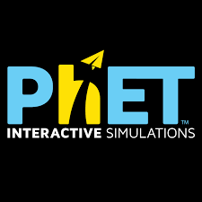




Subject Specific Softwares
AVAGADRO (https://avogadro.cc/) (Chemistry)
MARBLE (https://marble.kde.org/) (Science)
JMOL (http://jmol.sourceforge.net/) (Chemistry)
https://phet.colorado.edu/
KALZIUM (Chemistry)
STEP(KDE) (Physics)
ACD/ChemSketch (Chemistry)
SAGEMATHS (Maths)
GOOGLE EARTH (Science)
QGIS
GEOGEBRA (https://www.geogebra.org/?lang=en) (Maths)
STRELLARIUM (https://stellarium.org/)
(Science and Social Science)
https://edu.kde.org/kgeography/

Slide 32
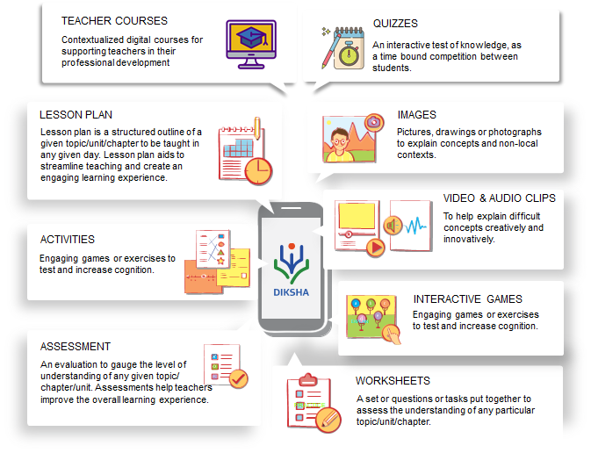
DIKSHA

Slide 33
PM e-VIDYA focuses on unification of efforts, enabling multi-mode access to education
PM e-VIDYA
https://ciet.nic.in/pages.php?id=pmevidya&ln=en
PM e-Vidya focuses on developing multi channel learning continuum
Television
Radio
DIKSHA
Special
e-Content
Online Courses
One Class, One TV Channel
Radio Broadcast / Podcast
One Nation, One Platform
E-content for specially DIVYANG
(CWSN)
Top 100 Universities to start online courses

Slide 34
An example of Augumented Reality
https://drive.google.com/file/d/19NPfkjBrtz4DzHcH144JJvKbybcn9E4Z/view?usp=sharing

Slide 35
Gamified learning
Students test their ideas, discuss their understanding with their peers and teachers, through interacting with scientific phenomena.
https://phet.colorado.edu/sims/html/balancing-chemical-equations/latest/balancing-chemical-equations_all.htm
l
Make it short-bite size
Keep learner interestedandengaged- include multiple startegies
Make itintractive
Use FOSS

Slide 36
Approaches of e-content teaching –learning
Blended learning
Flipped learning
Adaptive learning
Hybrid learning
Virtual Classroom

Slide 37
Virtual laboratory is used to …
Enhance conceptual understanding
Integrate it with relevant concepts
Illustrate various concepts
Familiarise with apparatus and equipment
Develop science process skills
Develop independent thinking and decision making

Slide 38
Objectives of laboratory work
Textbook of Pedagogy of Science (NCERT, 2013) suggests that use of laboratory must be focused towards achieving the objectives of developing
(a) cognitive abilities, i.e. principles and laws discussed in the classroom may precede or follow the laboratory work or it may be carried
out during discussion;
(b) process skills of science;
(c) scientific attitude and
(d) understanding nature of science.

Slide 39
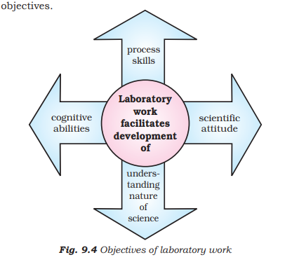
Objectives of laboratory work
Emphasis should be given to the first five letters of LABORATORY rather than the last seven letters.

Slide 40
Role of the laboratory
enhanced learning outcomes
development of scientific attitude
critical thinking,
conceptual understanding
development of science process and inquiry skills,
manipulative skills,
interests
retention of students in science education
ability to become independent learners

Slide 41
Attributes of scientific temper
Respect for evidence
Curiosity
Open mindedness
Suspended judgement
Critical thinking
Logical thinking
Ability to sieve relevant information,facts,concepts from the pool of irrelevant ones
Scepticism
Objectivity, unbiasedness
Truthfulness in reporting observations
Aversion to superstitions
Perseverance

Slide 42
Developing e- content in science
Focus on the thinking and reasoning skills of students that support the formation and modification of concepts and theories about the natural and social world.
Facilitate to develop skills involved in inquiry and experimentation.
Facilitate students to make logical relationships between evidence and explanations.
Support them to develop descriptions, explanations, predictions, and models on the basis of evidences.
Help them to evaluate evidences , and inference drawn that leads to conceptual change for conceptual understanding.

